Slide 1

PROJECT- PREDICTING LIFE EXPECTANCY
GROUP MEMBERS-
1)Ankita sahu
2)Atashi das
3)Meghna patnaik
4)Stuti sarita
5) g.Shravani
6)Nikita behera
Guided by-
Mr.parijat roy

Slide 2
Problem statement-
This project focuses on how some factors has an impact on life expectancies of different individuals belonging form different countries. Listing few features of our data set; Status , Adult Mortality ,infant deaths ,Alcohol ,percentage expenditure ,Hepatitis B, Measles , BMI ,Polio, Diphtheria , HIV/AIDS, GDP ,Population, Income composition of resources, Schooling etc
DATA SET- https://www.kaggle.com/kumarajarshi/life-expectancy-who/data?select=Life+Expectancy+Data.csv

Slide 3
PROJECT CYCLE LAYOUT-
DATA PREPROCESSING
Taking care of missing values.
MODEL ANALYSIS
Linear and polynomial regression
APPLYING NEURAL NETWORKS
Minimum validation loss
Graphs of countries with min and max life expectancy .
Scattered plot
PCA
Lasso
Ridge
Xgboost
Naïve bayes
Decision Tree
Model with 4 layers.
Model with 6 layers.

Slide 4
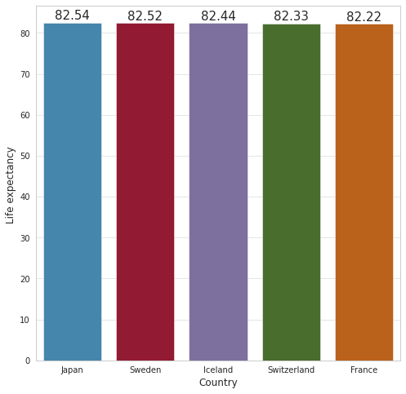
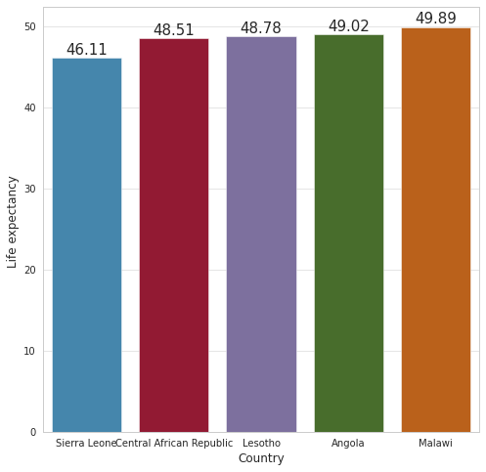
ANALYSING DATASET-
TOP 5 COUNTRIES HAVING MAX LIFE EXPECTANCIES
BOTTOM 5 COUNTRIES HAVING MIN LIFE EXPECTANCIES

Slide 5
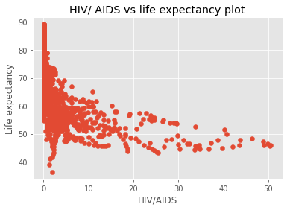
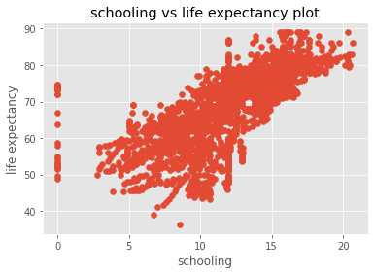
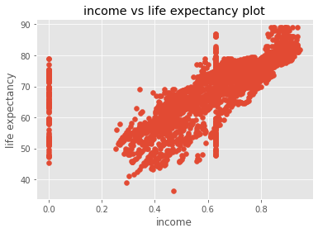
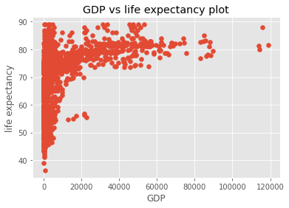
VISUALISING THE CORRELATIONS-

Slide 6
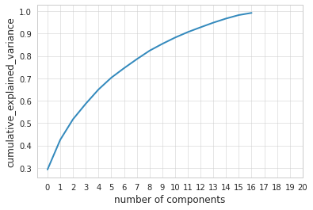
Principal Component analysis-PCA

Slide 7
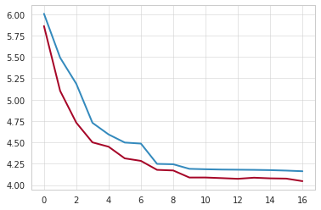
APPLYING REGRESSION MODELS ON OBTAINED FEATURES- 1)Plotting training error and test error obtained by implementing LINEAR AND POLYNOMIAL REGRESSION

Slide 8
REGRESSION MODELS AND ITS ACCURACIES-
1) RIDGE – 83.89%
2) LINEAR & POLYNOMIAL – 81%
3) XGBOOST – 80%
4) DECISION TREE-79%
5) LASSO –33.1%
6) NAIVE BAYES – 13%

Slide 9
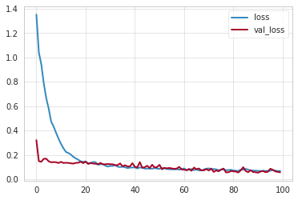
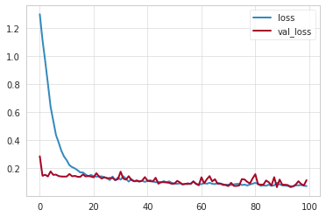
NEURAL NETWORK:-
Minimum validation loss taking – 6 layers is 0.0628
Minimum validation loss taking-4 layers is 0.0537

Slide 10
KEY INSIGHTS-
A country having a lower life expectancy value(<65) should increase its healthcare expenditure in order to improve its average lifespan.
As there is an impact of schooling on the lifespan of humans countries should work on it.
Keeping a check on the alcohol consumption of citizen.
As densely populated countries tend to have lower life expectancy , it should keenly work toward the immunization coverage of its country.

Slide 11
THANK YOU

